Slide 1
Route 53
Amazon Route 53 is a highly available and scalable Domain Name System (DNS) web service.
Translating names like www.example.com into the numeric IP addresses like 192.0.2.1 that computers use to connect to each other.
You can use Route 53 to perform three main functions:
Register domain names
Route internet traffic to the resources for your domain
Check the health of your resources
You can use Amazon Route 53 to register new domains, transfer existing domains.
Route traffic for your domains to your AWS and external resources, and monitor the health of your resources.
Top-Level Domain (TLD)
Top-level domain (TLD) refers to the last segment of a domain name
The Internet Corporation for Assigned Names and Numbers (ICANN), is the entity that coordinates domains and IP addresses for the internet.

Slide 2
TLDs are mainly classified into two categories:
Generic TLDs
Country-specific TLDs
Examples of some of the popular TLDs:
.com, .org, .net, .gov, .biz and .edu.
Some of the TLDs and their explanations are as follows:
.com - Commercial businesses
.org - Organizations (generally charitable)
.net - Network organizations
.gov - U.S. government agencies
.mil - Military
.edu - Educational facilities like universities
.th - Thailand
.ca - Canada
.au - Australia

Slide 3
Fully Qualified Domain Name (FQDN)
Take www.GoDaddy.com, for example. The first element and domain level of the FQDN is the top level domain (TLD), which, in this case, is “.com.” Within the TLD, “GoDaddy” is the assigned domain name/second-level domain. Lastly, “www.” is the hostname.
DNS management:
If you already have a domain name, such as example.com, Route 53 can tell the Domain Name System (DNS) where on the Internet to find web servers, mail servers, and other resources for your domain.
Hosted zone:
It is a container that holds information about how you want to route traffic for a domain, such as example.com, and its sub-domains.
Features of Route 53:
Easy to register your domain - We can purchase all level of domains like .com, .net, .org, etc. directly from Route 53.
Can be used with other AWS Services - Route 53 also works with other AWS services. It can be used to map domain names to our Amazon EC2 instances, Amazon S3 buckets and other AWS resources.
Easy to use - It is easy to sign-up, easy to configure DNS settings, and provides quick response to DNS queries.
Health Check - Route 53 monitors the health of the application. If an outage is detected, then it automatically redirects the users to a healthy resource.

Slide 4
How Internet Traffic Is Routed to Your Website or Web Application
Internet Protocol version 4 (IPv4) format, such as 192.0.2.44
Internet Protocol version 6 (IPv6) format, such as 2001:0db8:85a3:0000:0000:abcd:0001:2345
You register the domain name that you want your users to use to access your content.
After you register your domain name, Route 53 automatically creates a public hosted zone that has the same name as the domain.
To route traffic to your resources, you create records, also known as resource record sets, in your hosted zone.
Each record includes information about how you want to route traffic for your domain, such as the following:
Name:
The name of the record corresponds with the domain name (example.com) or subdomain name (www.example.com, retail.example.com)
Type:
The record type usually determines the type of resource that you want traffic to be routed to.
For example, to route traffic to an email server, you specify MX for Type. To route traffic to a web server that has an IPv4 IP address, you specify A for Type.

Slide 5
Supported DNS Record Types:
A The value for an A record is an IPv4 address in dotted decimal notation.(192.0.2.1)
AAAA The value for a AAAA record is an IPv6 address in colon-separated hexadecimal format.
(2001:0db8:85a3:0:0:8a2e:0370:7334)
CNAME A CNAME Value element is the same format as a domain name.
MX Each value for an MX record actually contains two values, priority and domain name:
(10 mail.example.com)
NS An NS record identifies the name servers for the hosted zone.The value for an NS record is the domain name of a name server.(ns-1.example.com)
PTR A PTR record Value element is the same format as a domain name.(hostname.example.com)
SOA A start of authority (SOA) record provides information about a domain and the corresponding Amazon Route 53 hosted zone.

Slide 6
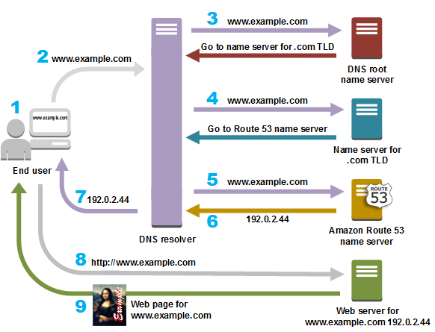
How Amazon Route 53 Routes Traffic for Your Domain

Slide 7
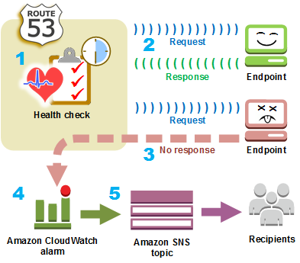
How Amazon Route 53 Checks the Health of Your Resources
Amazon Route 53 health checks monitor the health of your resources such as web servers and email servers.
You can optionally configure Amazon CloudWatch alarms for your health checks, so that you receive notification when a resource becomes unavailable.

Slide 8
Routing Policy:
Simple routing policy: Use for a single resource that performs a given function for your domain.you typically route traffic to a single resource, for example, to a web server for your website.
Failover Routing: Failover routing lets you route traffic to a resource when the resource is healthy or to a different resource when the first resource is unhealthy.
the primary and secondary records can route traffic to anything from an Amazon S3 bucket that is configured as a website.
Weighted Routing: Weighted routing lets you associate multiple resources with a single domain name (example.com) or subdomain name (acme.example.com) and choose how much traffic is routed to each resource.
Geolocation Routing: Geolocation routing lets you choose the resources that serve your traffic based on the geographic location of your users.
For example, you might want all queries from Europe to be routed to an ELB load balancer in the Ireland region.

